Slide 1
Packaging and Warehouse Quality Assurance: The Link between the Brewery and Happy Customers
Perry Dickerson- New Belgium Brewing

Slide 2
What’s the purpose of Packaging QA?
Guarantee business stability and profitability by ensuring consumers get a consistent, delicious product which meets their expectations every time
Assist packaging operations with managing raw material quality, preventing downtime to equipment and saving money on wasted materials
Facilitate process improvements that add value in the form of improved efficiency and higher quality

Slide 3
Warehouse impact on packaging quality- internal warehouse
Three key components for effective warehouse quality management:
  First in, first out- eases inventory control
  Product recall procedure- test for effectiveness
  Segregation of “hold” product- ensure it doesn’t get shipped or material used
It is also important to note that the warehouse is the last line of defense for packaging quality
  Attentive warehouse workers can sometimes catch packaging quality issues before the product gets to the customer
Notes:
Even the highest quality packaging materials can create problems if damaged in the warehouse
As in the six pack carrier example, inventory management plays a large role in material quality
First in, first out systems are commonly used to manage inventory
Less handling reduces opportunities for material damage

Slide 4
Distributor warehouse quality
Larger brewers manage distributor quality with auditing
  Temperature
  Product handling and storage
  Re-packing procedures
  Draught line cleaning
Smaller brewers cross their fingers
  Build partnerships
  Reinforce quality standards even if auditing is not an option
  Draught beer quality manual- standards for draught beer management set by consortium of brewers through the Brewers Association
Notes:
Checking systems to control temperature, storage- stack height- pyramiding, handling, re-packing
Draught beer quality manual- set standards for retail draft beer quality

Slide 5
Raw material quality management
Modern purchasing transition from lowest cost supplier to more holistic approach
Emphasize partnership aspects, brewers and suppliers benefit from improved quality
Modern statistical tools can be used to drive material quality- process capability around key parameters
Important to understand your process and what key material attributes need to be controlled for compatibility with equipment

Slide 6
Six pack carrier warp example
New Belgium- single six pack erector running at high speed (~135 carriers/ minute)
Erector is sensitive to warped carriers and with no back up machine can effect line performance greatly
Key attribute to carrier erector performance- age of carriers
New process for inventory management implemented with supplier, warped percentage lowered dramatically (from 3.3% to 0.59%)

Slide 7
Six pack carrier continued

Slide 8
In process quality
Government regulations dictate fill volume control and monitoring
Can seaming is a delicate business and creates large issues quickly if not controlled and tracked
Every brewer is concerned with shelf life, reducing total packaged oxygen drives extended product life
Sample frequencies should be determined based on individual processes- there is no “one size fits all” solution

Slide 9
World class quality tools
Using statistical process control tools helps to reduce variation, improve consistency and learn about your processes
  Only react to statistically significant results, not every result- better process control
Operator ownership of quality- allows those closest to the process to monitor and make adjustments when necessary
Quality personnel can focus on building systems that sustain gains and attack problems

Slide 10
Fill volume, bottle mold example
Close monitoring of fill volumes revealed a step shift and improvement in consistency
Further investigation showed the change resulted from bottle manufacturer using a new bottle mold
Information can be used to help the bottle manufacturer determine when to replace molds

Slide 11
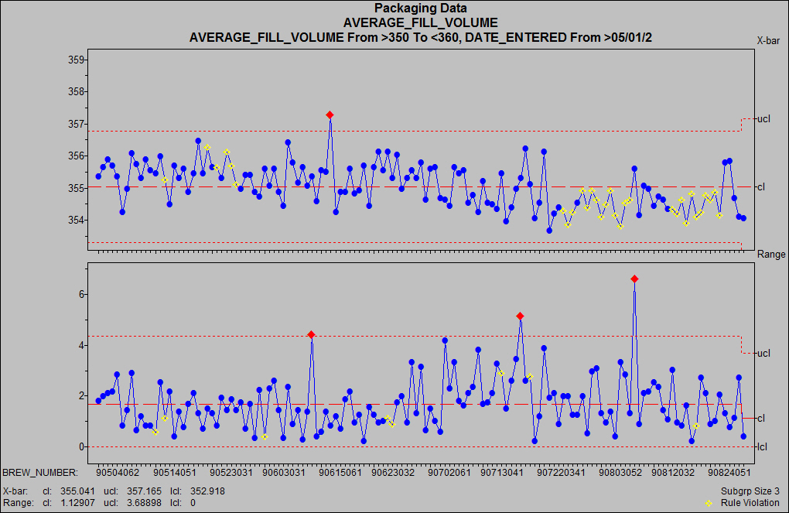
Fill volume continued
New bottle mold from vendor

Slide 12
Summary
Packaging and warehouse quality assurance is the last line of defense before the consumer gets our products
Proactive quality systems prevent large and costly downstream recalls and negative consumer impressions
Building a strong quality system is the key to consistently maintaining a high quality product and happy customers

Slide 13
Resources
Draught beer manual from the Brewers Association:
  http://www.draughtquality.org/
Statistical and quality management from the American Society for Quality:
  http://www.ASQ.org/
ASBC: http://www.asbcnet.org/
MBAA: http://www.mbaa.com/
Not to be confused with MBAAA (Manitoba Midget AAA Hockey League): http://www.mbaaa.ca/
Perry Dickerson: pdickerson@newbelgium.com

